Slide 1
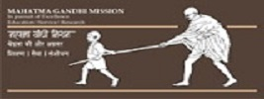
SENIOR CITIZENS IN INDIA HEALTH RELATED LEGAL RIGHTS & BENEFITS FOR THE ELDERLY Dr. Doss Prakash Dept. OF community physiotherapy MGM institute of physiotherapy chh. samBhajingar

Slide 2
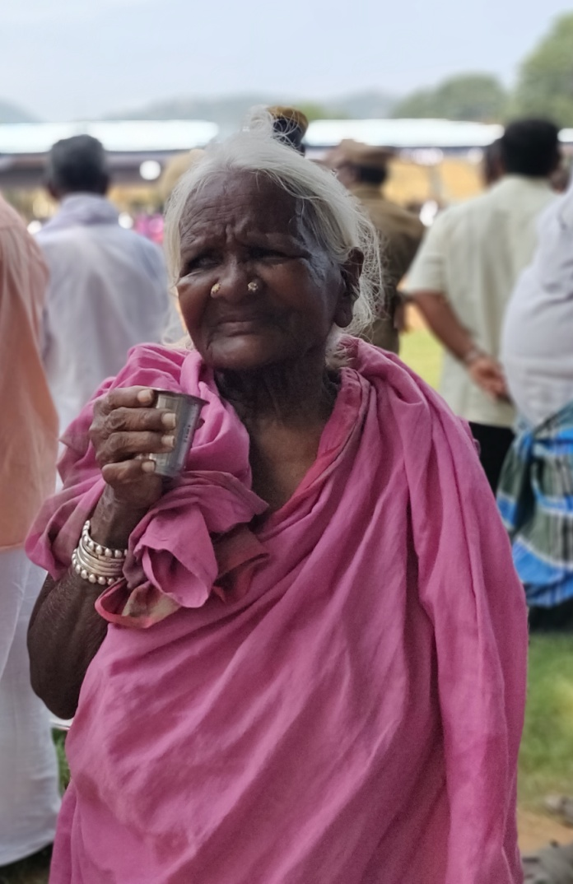

Slide 3
GoI adopted ‘National Policy on Older Persons’ in January, 1999 which defines ‘senior citizen’ or ‘elderly’ as a person who is of age 60 years or above.

Slide 4
Ageing definition
Progressive process
Associated with decline in structure and function,
impaired maintenance and repair systems,
reduced reproductive capacity and
increased susceptibility to disease and death

Slide 5
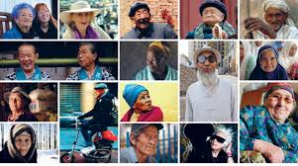
Ageing is defined as a progressive process associated with declines in structure and function, impaired maintenance and repair systems, reduced reproductive capacity, and increased susceptibility to disease and death.

Slide 6
Registrar General & Census Commissioner reports by GoI
2001
7.4%
77 million
39 million females
38 million males
2011
8.6%
104 Million
53 million females
51 million males
71% of elderly persons were living in rural areas.

Slide 7
A report released by the United Nations Population Fund and HelpAge India
173 million by 2026.
(104 m in 2021)

Slide 8
OVERVIEW
75% - Rural
73% - Dependent & illiterate
66% - BPL
66% - Vulnerable & without food
48% - Women

Slide 9
OVERVIEW
Surveys have found that
1/ 6 urban older persons aren't obtaining proper nutrition,
1/ 3 three older persons have no access to healthcare
1/ 2 older persons don't receive due respect or good conduct from family members or people in general.

Slide 10
Increase in old-age homes
In today's state of urbanization in which women are increasingly joining the workforce, the roots of joint family systems are eroding.
Higher numbers of older people who have spent most of their life with their joint/extended families may face loneliness and marginalization in their old age.
In rural areas the older members of families, (i.e.: people who are above 60 years of age), are respected more and are considered a strong part of the family as the joint family system remains part of their roots.

Slide 12
Issues of ageing population
Poverty
Illiteracy
Employment
Dependency
Living conditions
Dementia & Alzheimer's
Health issues
Elder abuse
Neglect

Slide 13
Common medical problems faced by the elderly
Dual medical problems, i.e., both communicable as well as non–communicable diseases.
Impairment of special sensory functions like vision and hearing.
A decline in immunity as well as age-related physiologic changes leads to an increased burden of communicable diseases in the elderly.
The prevalence of tuberculosis is higher among them
It is shown that among the population over 60 years of age, 10% suffer from impaired physical mobility and 10% are hospitalized at any given time, both proportions rising with increasing age.
In the population over 70 years of age, more than 50% suffer from one or more chronic conditions.
The chronic illnesses usually include hypertension, coronary heart disease, and cancer.

Slide 14
Other issues
Highly prone to mental morbidities due to ageing of the brain, problems associated with physical health, cerebral pathology, socio-economic factors such as breakdown of the family support systems, and decrease in economic independence.
The mental disorders that are frequently encountered include dementia and mood disorders. Other disorders include neurotic and personality disorders, drug and alcohol abuse, delirium, and mental psychosis.

Slide 15
Mortality - according to Government of India statistics
Cardiovascular disorders – One-third of elderly mortality.
Respiratory disorders - 10% mortality while infections including tuberculosis account for another 10%.
Neoplasm accounts for 6% and
Accidents, poisoning, and violence constitute less than 4% of elderly mortality with more or less similar rates for nutritional, metabolic, gastrointestinal, and genito-urinary infections.

Slide 16
Mortality
According to Government of India statistics, cardiovascular disorders account for one-third of elderly mortality.
Respiratory disorders account for 10% mortality while infections including tuberculosis account for another 10%. Neoplasm accounts for 6% and accidents, poisoning, and violence constitute less than 4% of elderly mortality with more or less similar rates for nutritional, metabolic, gastrointestinal, and genito-urinary infections.

Slide 17
Problems of the elderly
Problem | Need
Deterioration of health | Medical attention
Economic insecurity | Financial Security
Isolation | Inclusion
Neglect | Care
Abuse | Protection
Fear | Reassurance
Boredom | Engagement
Lowered self-esteem | Self-confidence
Loss of control | Respect
Lack of preparedness for old age | Preparing for old senile age

Slide 18
IYOP - UN
It was a step in the right direction in pursuance of the UN General Assembly Resolution to observe 1999 as International Year of Older Persons (IYOP)
The National Policy on Older Persons was announced by the Government of India in the year 1999.

Slide 19
SIGNATORIES & GLOBAL GUIDELINES
The Madrid Plan of Action
The UN Principles for Senior Citizens adopted by the UN General Assembly in 2002
The Shanghai Plan of Action 2002
The Macau Outcome document 2007
The Government of India is a signatory to all these documents demonstrating its commitment to address the concerns of the elderly.

Slide 20
Indian Constitution

Slide 21
Next

Slide 22
National Council of Older Persons
Constituted in 1999 to monitor the implementation of the Policy and advise the Government on issues related to the welfare of senior citizens.
The Council has been reconstituted in 2012 as National Council of Senior Citizens with wider national impact.

Slide 23
Salient Features of NPOP
Financial Security
Health care & Nutrition
Education
Welfare
Protection of life & property
Shelter
Basic facilities
NGO’s
Research &
Improve the quality of their lives.

Slide 24
LEGAL RIGHTS
Maintenance and Welfare of Parents and Senior Citizens Act, 2007
legislation passed by Ministry of Social Justice and Empowerment,
Government of India

Slide 25
Rights of the law
To provide more effective provision for maintenance and welfare of parents and senior citizens.
It makes it a legal obligation for children and heirs to provide maintenance to senior citizens and parents, by monthly allowance. It also provides simple, speedy and inexpensive mechanism for the protection of life and property of the older persons.

Slide 26
NATIONAL PROGRAMME FOR HEALTH CARE OF THE ELDERLY(NPHCE)
Keeping in view the recommendations made in the “National Policy on Older Persons” as well as the state’s obligation under the Maintenance & Welfare of Parents & Senior Citizens Act 2007”, The MoHFW launched the NPHCE during the year 2010-11

Slide 27
Vision of the NPHCE are
(1) To provide accessible, affordable, and high-quality long-term, comprehensive and dedicated care services to an ageing population;
(2) Creating a new “architecture” for Ageing;
(3) To build a framework to create an enabling environment for “a Society for all Ages;”
(4) To promote the concept of Active and Healthy Ageing.
The Centre will bear 75% of the total budget and the State Government will contribute 25 % of the budget.

Slide 28
Main Strategies of NPHCE
Preventive & promotive care
Management of illness
Man power development
Medical Rehab & therapeutic intervention
IEC

Slide 29
MEDICAL BENEFITS
Department of Geriatric at 8 Super Specialized Institutions
Geriatric Unit at 100 District Hospitals
Rehabilitation units at CHCs falling under 100 identified districts
Weekly geriatric clinics in PHC
Subcentres – Identification, screening,
Free, specialized health care facilities exclusively for the elderly people through the State health delivery system

Slide 32
Indian airlines provide 50% concessions in its economy class, (with particular terms and conditions applied). Air India provides 45% concessions to older persons in wheel chairs and are allowed to board the plane first.

Slide 33
FINANCIAL BENEFITS
Higher rates of interest to its senior citizens on certain savings plans which are run by the post offices and other private banks.
IT rebate – Income upto Rs.3L (60 & above)
Separate wards for filing IT returns
ITR filing exemption – Above 75 years
Reverse Mortgage Scheme

Slide 34
FINANCIAL SCHEMES
Indira Gandhi National Old Age Pension Scheme (IGNOAPS)

Slide 35
LEGAL BENEFITS
Priority to cases related to geriatric age group
Fast disposal of cases
Provisions of Chapter III of Hindu and Chapter IX of Code of Criminal Procedure – Old age persons can claim maintenance from children
Free legal aid
Hindu adoptions and maintenance act
Domestic violence act

Slide 36
OTHER FINANCIAL SUPPORT
Pradhan Mantri Vaya Vandana Scheme
Varistha Mediclaim Policy
Rashtriya Vayoshri Yojana
Varishta Pension Bima Yojana by LIC
Senior Citizens' Welfare Fund – MoSJE Savings
Vayoshreshtha Samman – National awards for senior citizens (Courage & Bravery)
Pradhan Mantri Jan Arogya Yojana – Insurance upto 5L for hospitalization & treatment

Slide 38
INTERNATIONAL DAY OF OLDER PERSONS – 01st OCTOBER

Slide 39
Others
The attempt to improvise geriatric educational programmes at medical and public health institutes can be elaborated by extending the education to Ayurveda, Yoga and Naturopathy, Unani, Siddha and Homeopathy (AYUSH)
Community Health Nurse
Community Physiotherapist
Community Pharmacist

Slide 40
NGO’s
Manavlok – Community Kitchen (Ambajogai dt)
Helpage India – Restoration of Vision
Abhoy’s Mission – Ration for month & medical treatment (Sponsor a grand parent)
Dignity Foundation – Skill building activities
DevMitra Foundation – Medical Treatment
Vridhcare – Partners with CSR firms of corportae companies and provide infrastructure support
ELDER SPRING & ELDER LINE by TATA Trusts
National helpline - 14567

Slide 41
THANK YOU

